Slide 1
Bit304 interim presentation BeautéPanda: Android Application for Beauty Enthusiasts
Ayu Chrisniyanti – E1500352
Lovely – E1500367

Slide 2
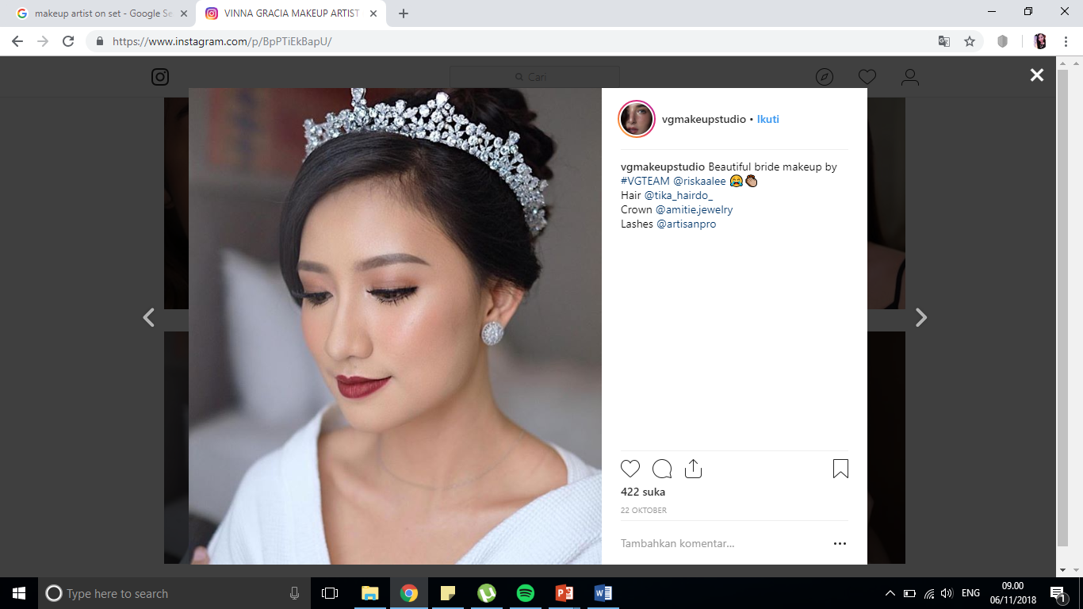
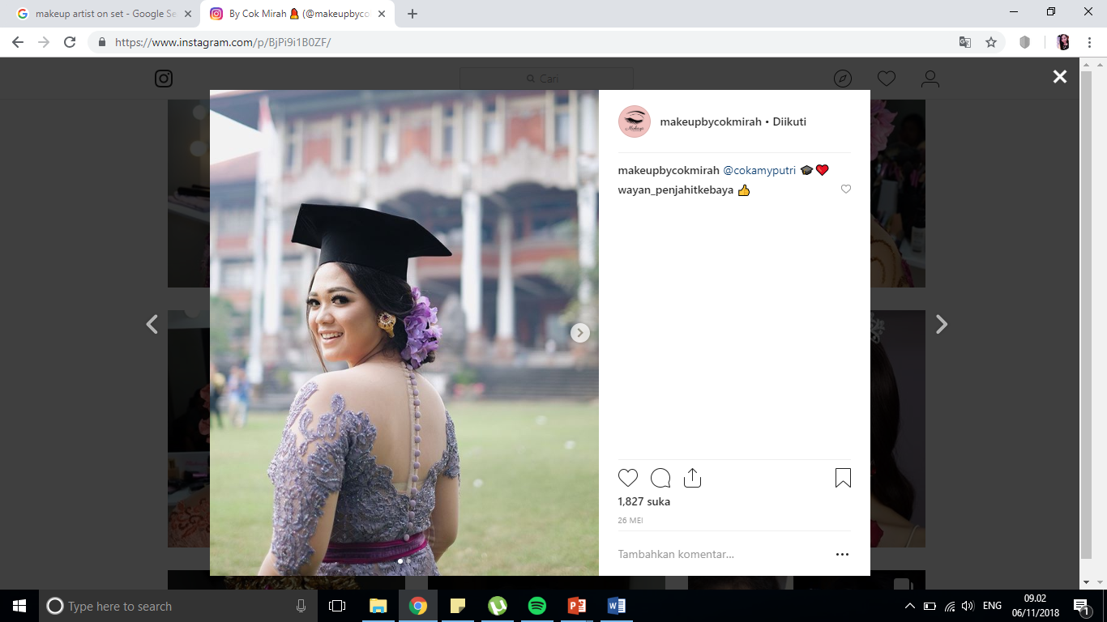
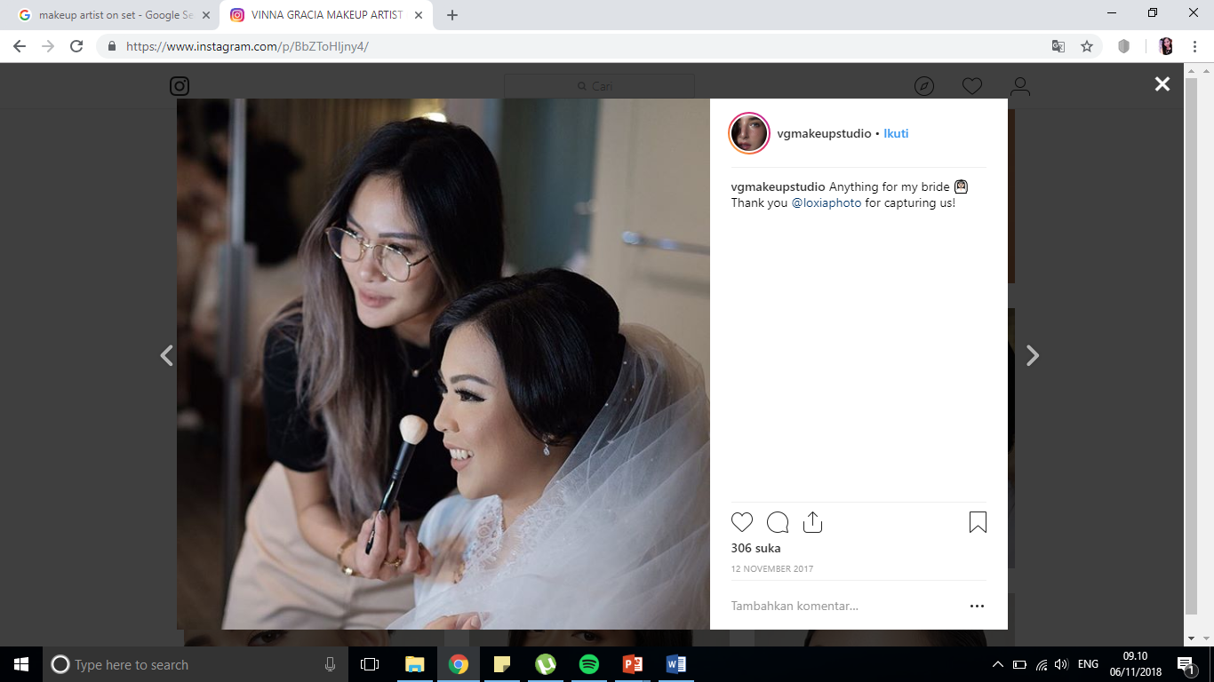
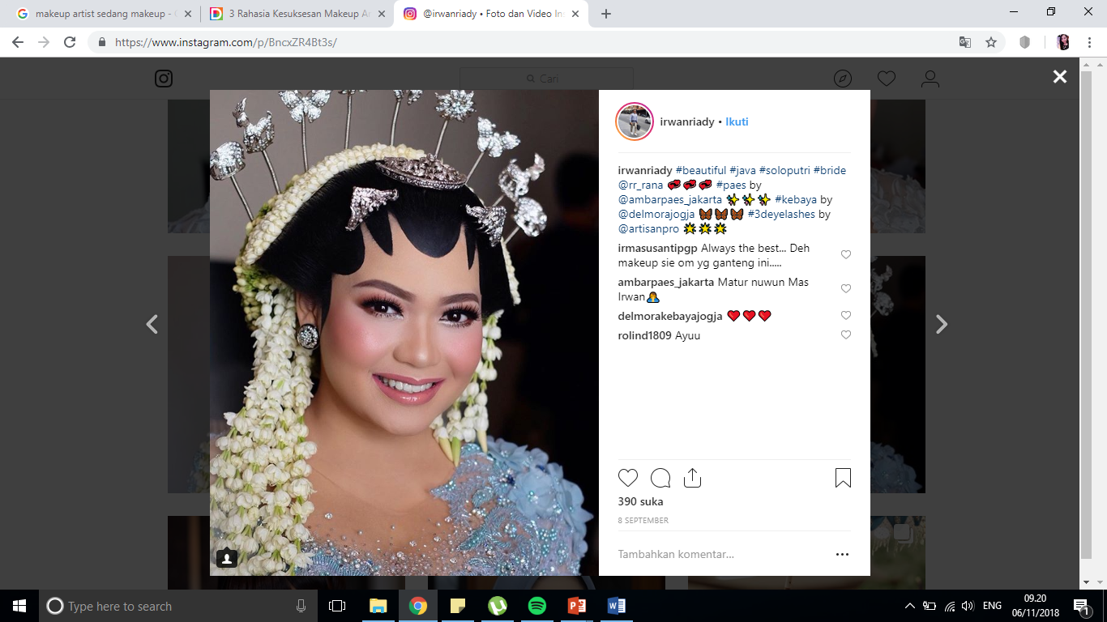
Project background
Makeup has become a necessity when women have to attend an event, such as wedding, graduation, birthday parties and many more.
However, not every woman can do their own makeup, so most of them prefer to find makeup artist or go to beauty salon to get their makeup done
Notes:
In Indonesia, and especially in Bali there are many traditional ceremonies that require specific makeup for women. So the demand for makeup artist will be higher

Slide 3
Project background
The current practice to find makeup artists is usually through social media such as Instagram and Facebook, for example by searching for hastags like #makeupartistsbali
But for more information, usually these makeup artists don’t want to give information through direct message in Instagram or Facebook, but through other application such as Whatsapp
It is still difficult to find makeup artists, compare them, and contact them within one application

Slide 4
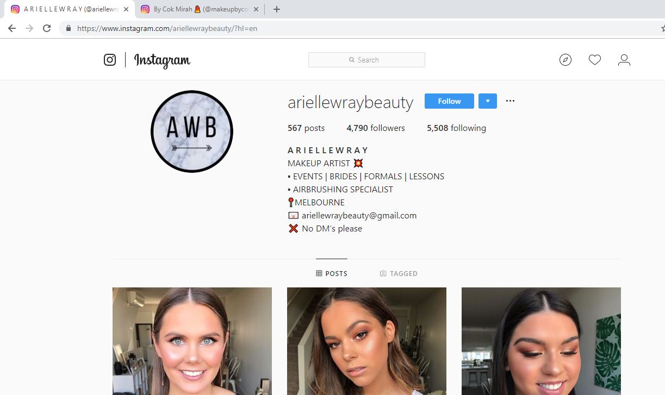
Notes:
This is the example of makeup artist that promotes herself through Instagram. But she will not reply direct message in Instagram, and only communicate with potential customers through email., which can be complicated. Although this example is not from Indonesia, but many Indonesian makeup artists do the same thing.
Because of this reason, we decide to create BeautePanda android application to solve this problem.

Slide 5
Project AIM
“To provide a platform for people who want to find makeup artists or beauty salons, and they can easily compare and contact the makeup artists”

Slide 6
Project objectives
Facilitate user to see the portfolio and prices of the makeup artists and salons
Facilitate makeup artists and salons to offer their services and reach the target customer
Allowing user to give reviews and see the feedback from other use
Provide communication channel between the makeup artists/salons and user (their potential customers)
Facilitate making appointment between user and the desired makeup artist/salon
Provide information about beauty trends and news to increase the knowledge of user
Provide simple yet beautiful and easy-to-use interface that can be understood by user
Notes:
Additional after 4th : so this application will include instant messaging feature where user can ask for information from the makeup artists or salon
Additional after 5th : the appointment will be recorded by the application and it will send notification one day before and several hours before the appointment, to remind the both parties about it

Slide 7
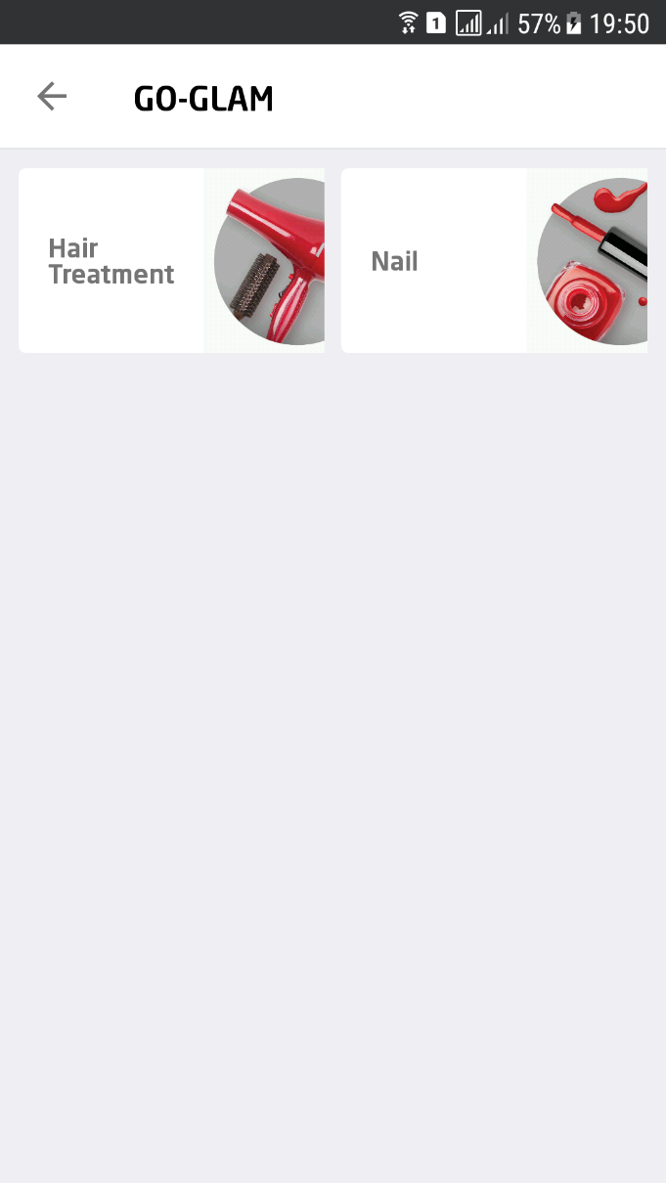
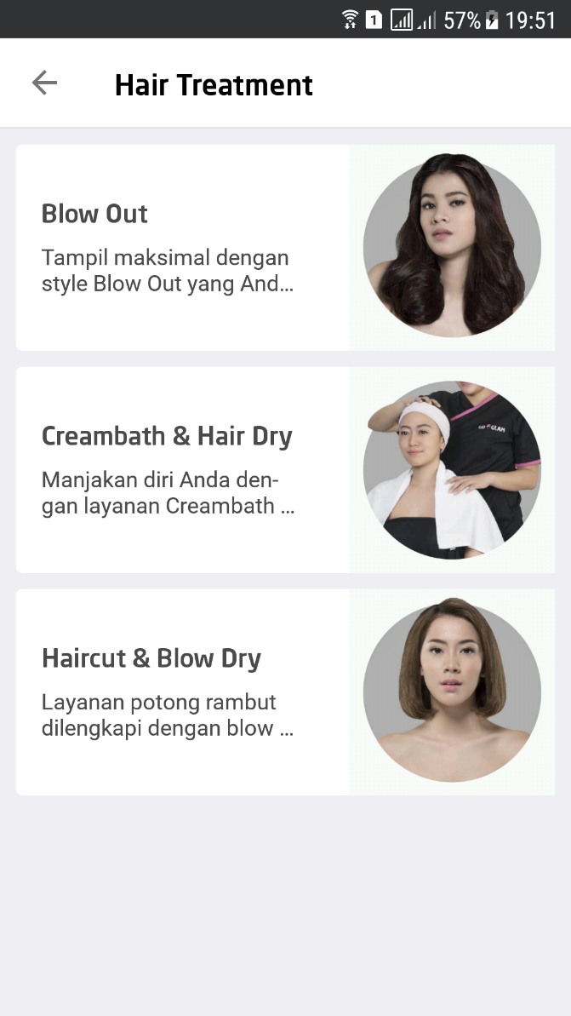
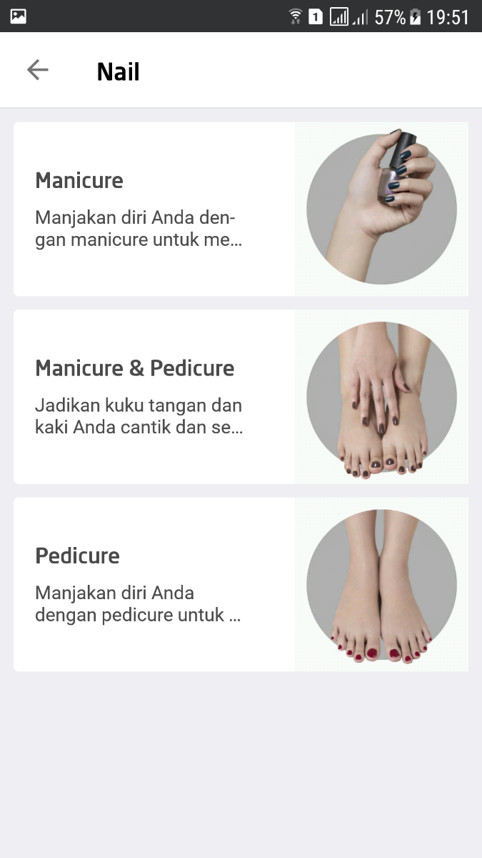
Similar applications – Go Glam
Notes:
From the project objectives, we have found some applications that have similar purpose like our application, the first one is Go – Glam by Gojek. It is an application to order beauty service and the person will come to the user’s house. However, for now this application only provides two services which are hair and nails treatment. Additionally, user cannot choose specific person to deliver the service.

Slide 8
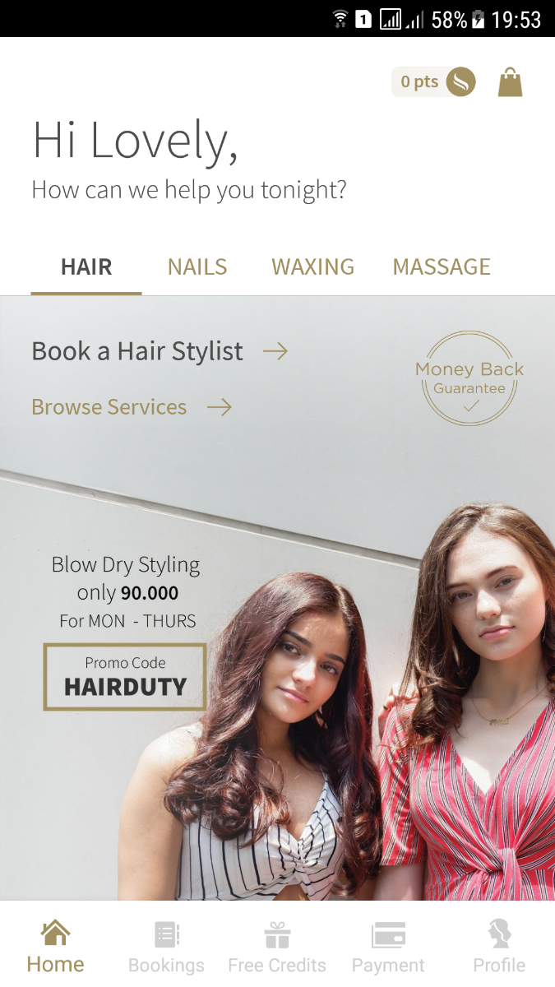
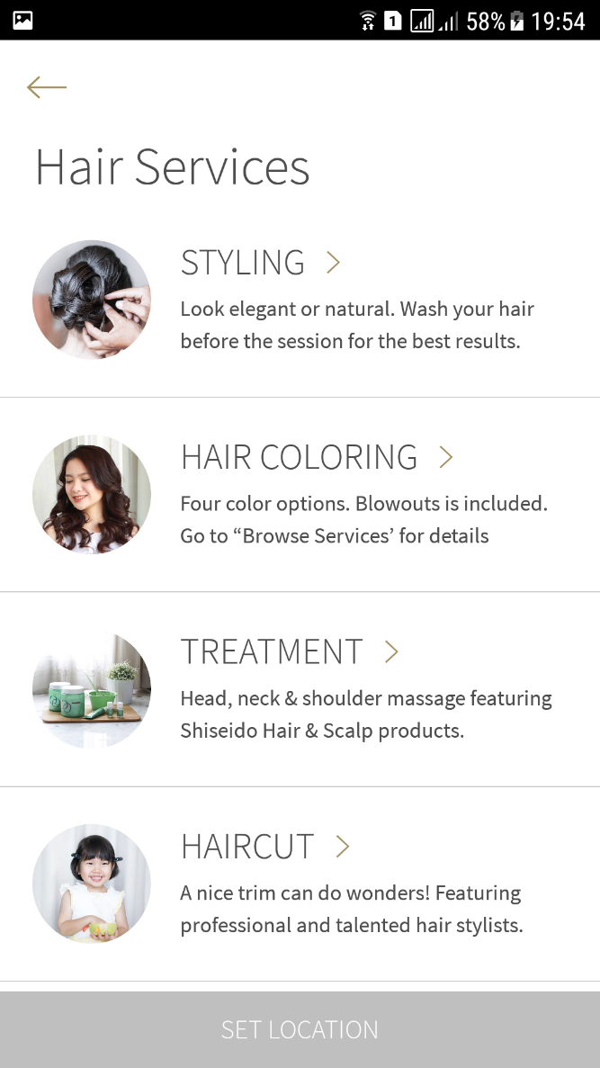
Similar applications - SALON by HouzCall
Notes:
The second application is SALON by HouzCall. This application provides the customer with booking menu where the customer can book for more than one person for beauty service. However, this application did not provide makeup service and same like Go-Glam, user cannot choose specific person to deliver the service.

Slide 9
Hardware requirements
No | Item | Usage | Qty. | Cost
Hardware
1 | ASUS laptop X450J series | Project development | 1 | Available
2 | Apple MacBook Pro Mid 2012 | Project development | 1 | Available
3 | Samsung Galaxy A5 | Project testing | 1 | Available
4 | Epson L210 printer | Document printing | 1 | Available

Slide 10
software requirements
Operating system
5 | Windows 10 | Project development | - | Available
6 | MacOS Sierra 10.12.3 | Project development | - | Available
7 | Android Nougat 7.0 | Project testing | - | Available
Tools Used
8 | IntelliJ IDEA Community Edition 2018.2.4 | Android application development | - | Available

Slide 11
software requirements
9 | Adobe Photoshop CS6 | User interface design | - | Available
10 | Microsoft Visio Pro 2013 | Drawing UML diagrams | - | Available
11 | GanttProject 2.8.5 | Creating project schedule | - | Available
12 | Microsoft Office Word 2013 | Creating project document | - | Available
13 | Microsoft Office PowerPoint 2013 | Creating presentation for the project | - | Available

Slide 12
Literature review
The use of makeup artists have started from the Egyptians time. They were actually servants for people from the higher class in the society, who could afford to hire someone to take care for their physical appearance.
In the 20th century, makeup artistry began to gain acceptance as a real profession due to advancement in cinematographic technology and popularity of fashion shows.
Now in the 21st century, cosmetics are affordable and used by women from every social class. It can be applied as needed, and it works as a temporary boost in self-esteem.

Slide 13
Literature review
Nowadays, Android Operating System is growing faster than iOS. Its market share is 48.8% which is wider than iOS where iOS only has 17.2% of market share.
Android offers all the developers with the ability to develop and build an innovative application. In 2011, Google announced that their Android apps had been about 100.000 installed around the world.

Slide 14
Methodology used – Agile
Agile is suitable for mobile application development because it is based on people and embracing their changing needs.
It is a good approach for flexible and turbulent environment such as mobile market, where changes can happen anytime.
Moreover, the team that develop the application using agile should have a main focus towards fulfilling customer requirements.
Notes:
At the end : mobile application development is relatively new, so we believe that more traditional approach such as Waterfall would not be suitable. Mobile technology and trends are always changing, which means traditional software development methodologies would be unable to handle these challenges and the technical limitations that mobile market has

Slide 15
Gantt chart
<isi gantt chart paling baru>
Notes:
This our project schedule. This project starts at the end of September and ends on December. The next milestone after this presentation is submitting chapter 3 of the final report documentation, which is due on twenty third November.

Slide 16
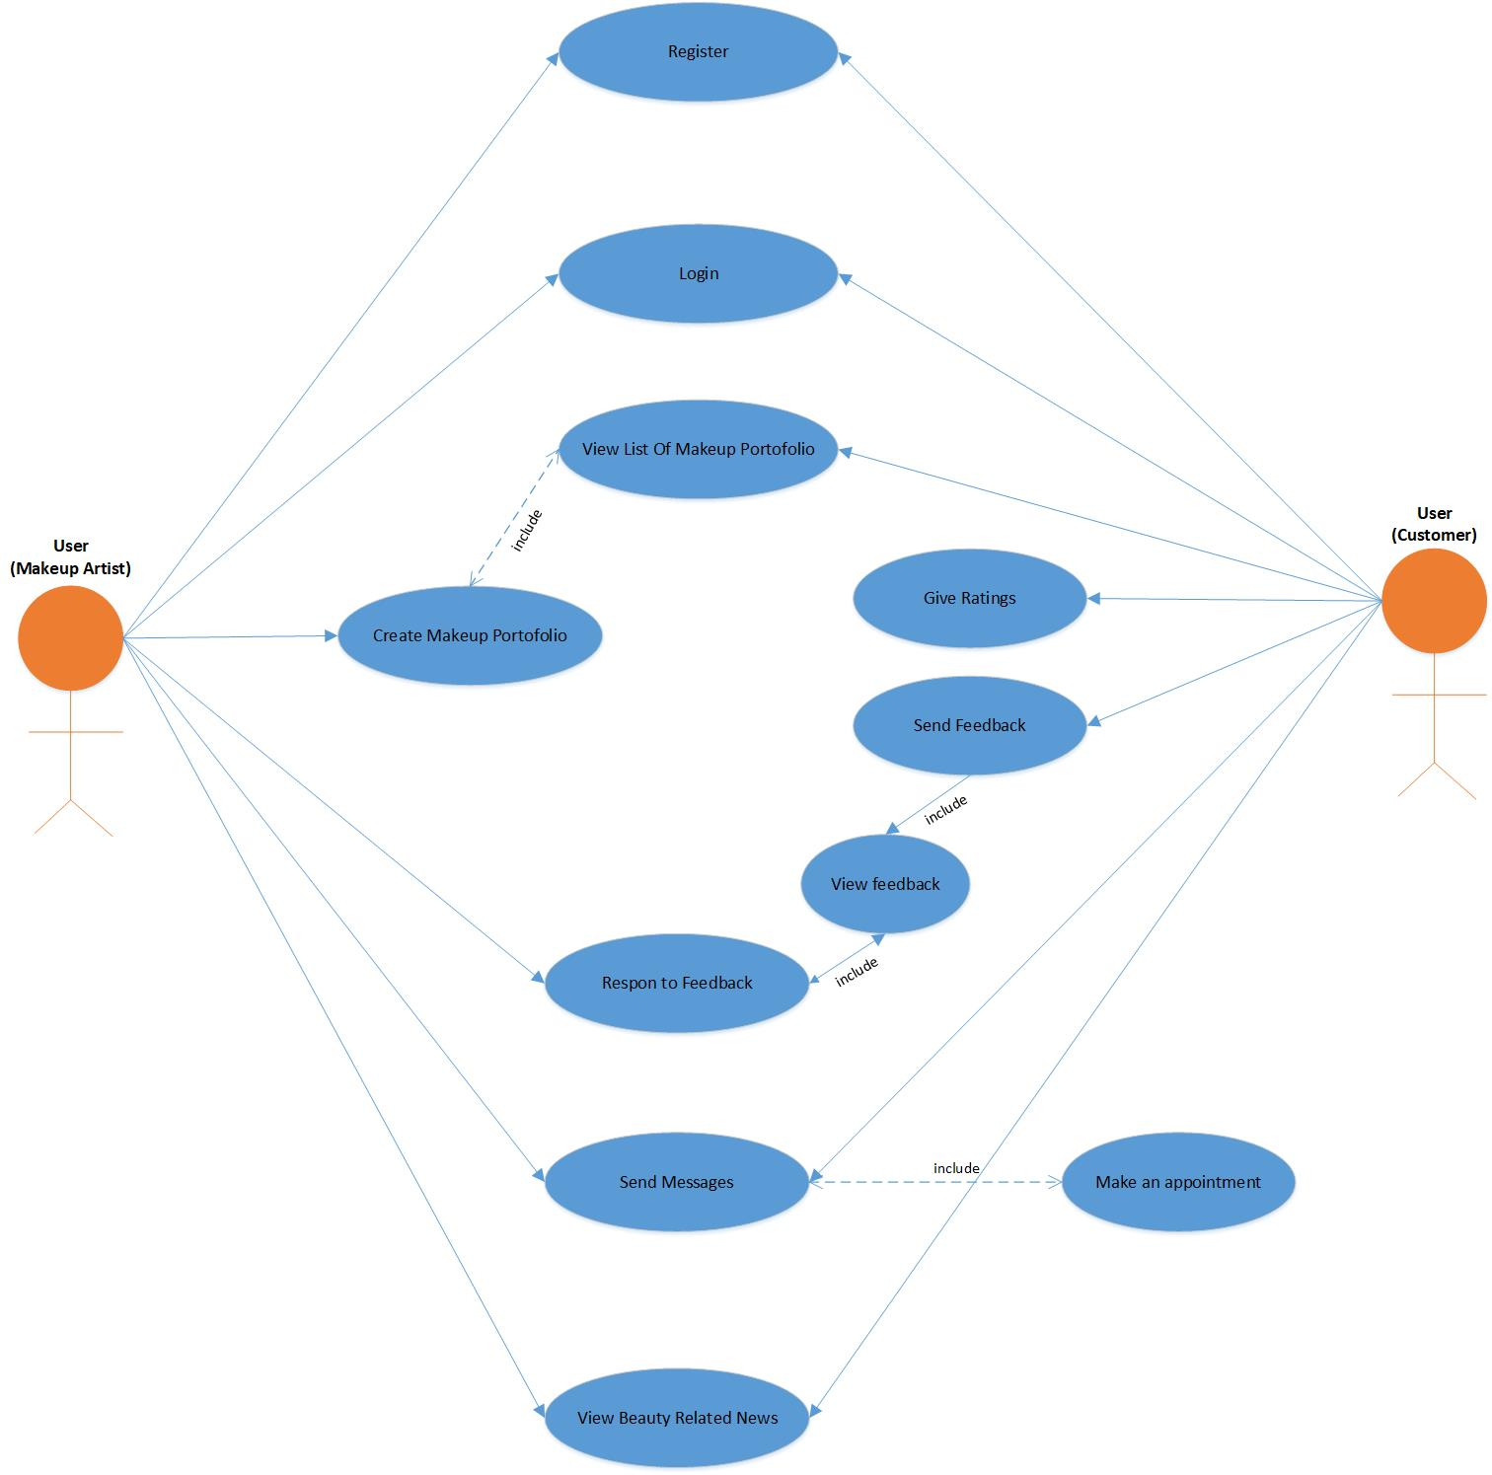
Use cases

Slide 17
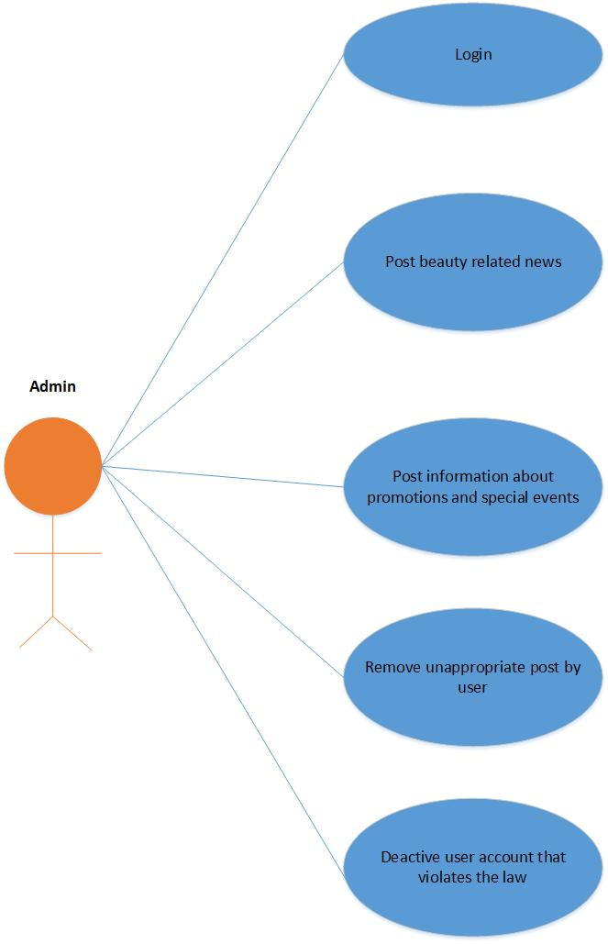
Use cases

Slide 18
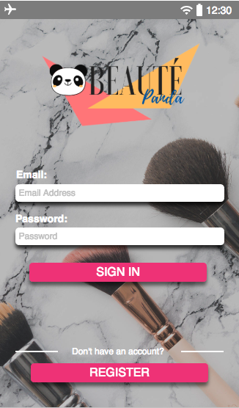
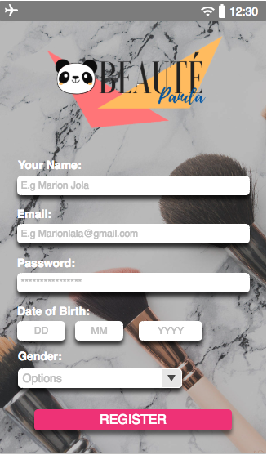
prototype

Slide 19
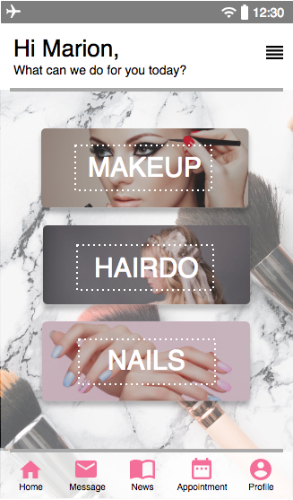
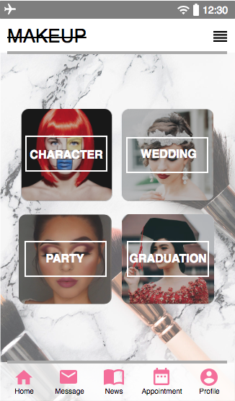
prototype

Slide 20
Deliverables up to date
Project Plan
Project Management Plan
Literature Review

Slide 21
Work to be achieved
Prototype of the application
Final documentation
Notes:
So until end of December, we have to produce the prototype of the application and complete the documentation for our final report

